Slide 1
Convexity and Global Optimality
IDS 435
Instructor: Selva Nadarajah

Slide 2
Discussion Plan
Convex sets
Convex functions
Global optimality

Slide 3
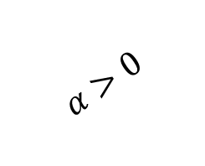


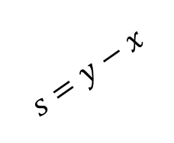





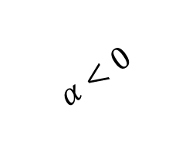
Line and Line Segment
A line is defined by a point $x$ and a direction $s$
$$x+αs,∀α∈R$$
A line segment is defined by two points $x$ and $y$
$$x+α\left(y−x\right),∀α∈[0,1]$$
Once can view the direction as $s=y−x$
$$α>0$$
$$α<0$$
$$s$$
$$y$$
$$x=(1,2)$$
$$s=y−x$$
$$x$$
$$x+αs, 0≤α≤1$$

Slide 4
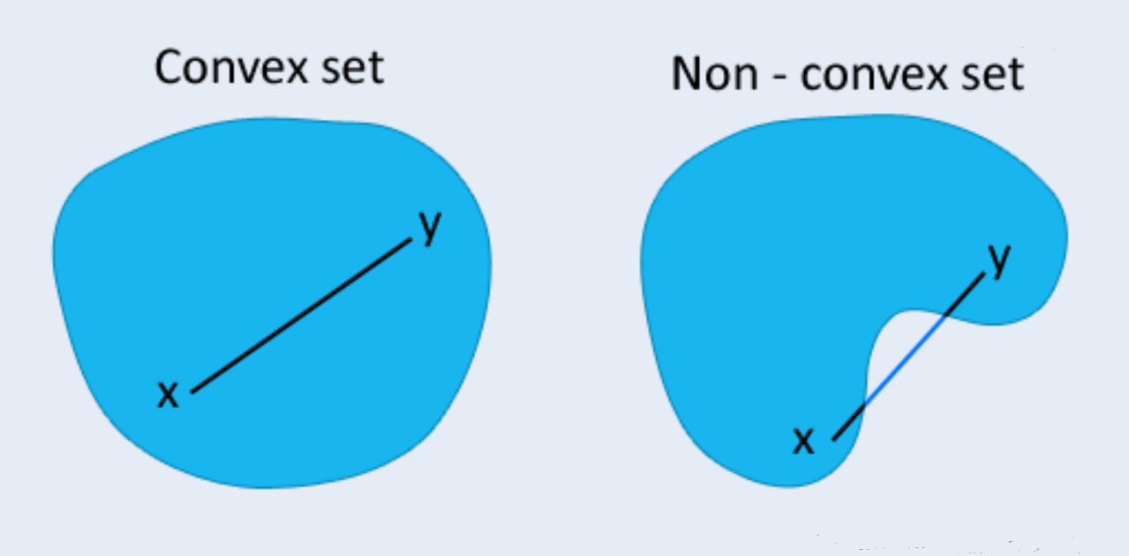

Convex Set
Set $C$ is convex if for $x,y∈ C$ the line segment between these two points is also in $C$
More formally, set $C$ is convex if for $x,y∈ C$ and any $α∈ [0,1]$,
$$α x + \left(1−α\right)y∈ C$$

Slide 5

Examples
All of $R^{n}$: $x∈R^{n}$
Non-negative orthant: $x∈R_{+}^{n}$ (i.e., $x∈R^{n}$ and $x≥0$) Pick $x,y≥0$, then for $α∈[0,1]$ we have $z=αx+\left(1−α\right)y≥0$
since $\left(1−α\right)∈[0,1]$.

Slide 6
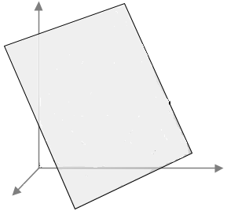

Examples
Affine subspaces: $Ax=b$ Suppose $Ax = b$ and $Ay = b$, then for $α∈\left[0,1\right]$ $A\left(αx + \left(1 − α\right)y\right) = αAx + \left(1 − α\right)Ay$ $= αb + \left(1 − α\right)b$ $= b.$
Affine halfspace: $Ax≤b$ (similar to the above)

Slide 7

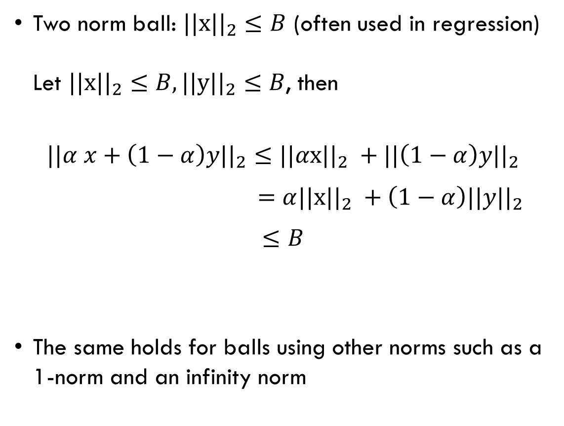
Examples
Two norm ball: $||x||_{2}≤B$ (often used in regression) Let $||x||_{2}≤B,||y||_{2}≤B$, then
$$||α x+\left(1−α\right)y||_{2}≤||αx||_{2} +||\left(1−α\right)y||_{2}$$ $=α||x||_{2} +\left(1−α\right)||y||_{2}$
$$≤B$$
The same holds for balls using other norms such as a 1-norm and an infinity norm
$$B$$

Slide 8
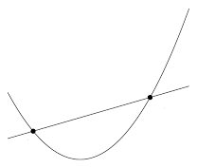



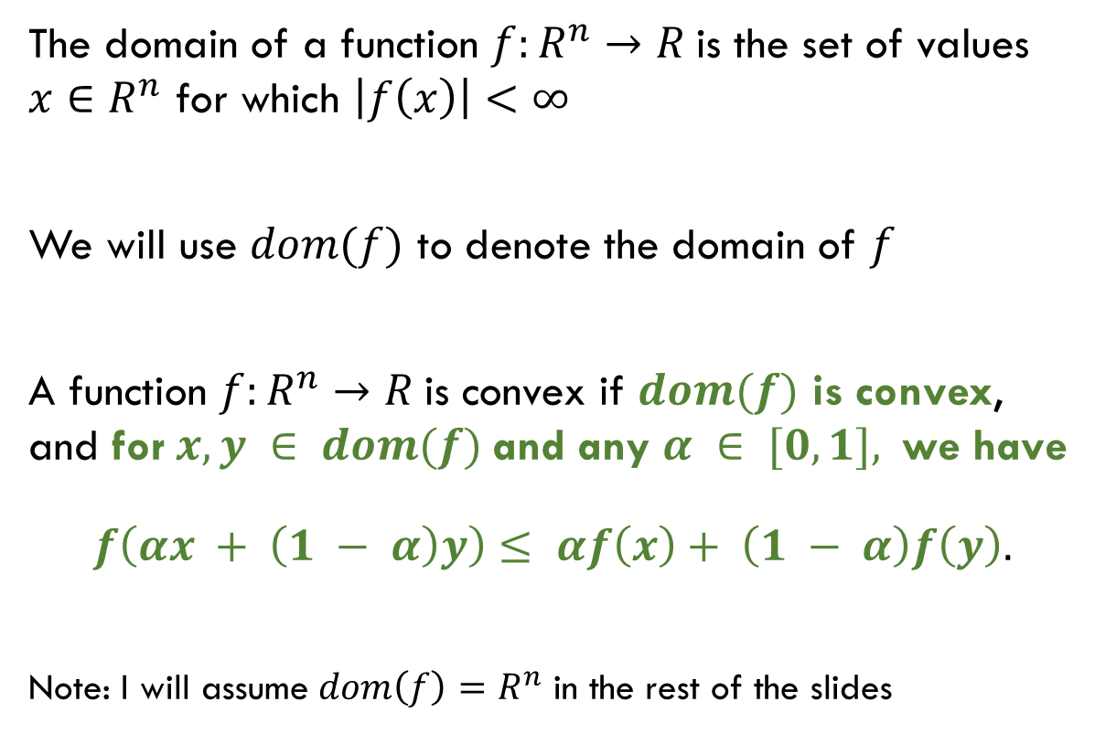


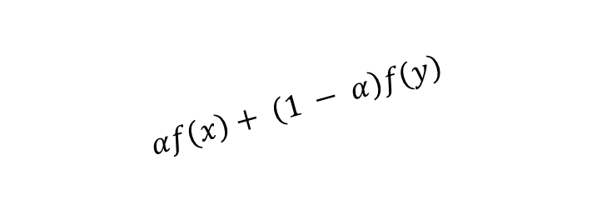
Convex Function
The domain of a function $f:R^{n}→R$is the set of values $x∈R^{n}$ for which $\left|f\left(x\right)\right|<∞$
We will use $dom(f)$ to denote the domain of $f$
A function $f:R^{n}→R$is convex if $dom(f)$ is convex, and for $x, y ∈ dom(f)$and any $α ∈ [0, 1],$ we have
$$f\left(αx + \left(1 − α\right)y\right)≤ αf\left(x\right)+ \left(1 − α\right)f\left(y\right).$$
Note: I will assume $dom\left(f\right)=R^{n}$ in the rest of the slides
$$αf\left(x\right)+ \left(1 − α\right)f\left(y\right)$$
$$f(y)$$
$$f(x)$$
$$x$$
$$αx+ \left(1 − α\right)y$$
$$y$$

Slide 9

Example: Affine Function
$$f(x) = b^{T}x+c$$

Slide 10

Example: Two norm
$$f(x) ={\left\|x\right\|}_{2}$$

Slide 11
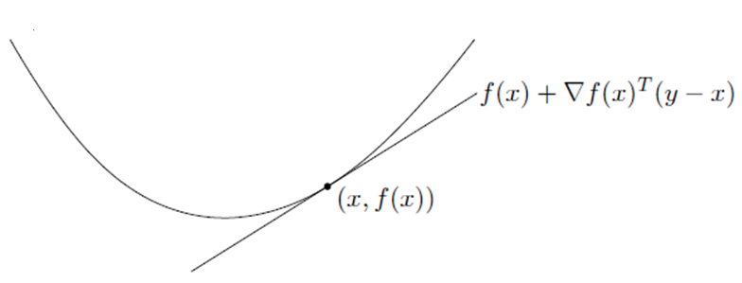

First Order Convexity Characterization
Suppose $f:R^{n}→R$is differentiable. Then $f$ is convex if and only if for all $x, y ∈R^{n}$
$f(y) ≥ f(x) + ∇f{\left(x\right)}^{T}(y − x)$

Slide 12
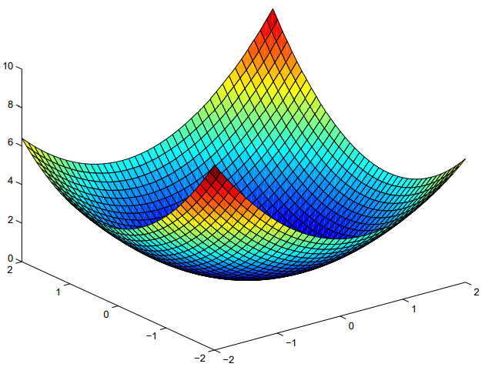

Second Order Convexity Characterization
Suppose $f:R^{n}→R$is twice differentiable. Then $f$ is convex if and only if for all $x ∈R^{n}$, we have
$$∇^{2} f(x)≽ 0.$$

Slide 13

Example: Quadratic Function
For $A ≽0$, the following quadratic function is convex:
$$f\left(x\right)=\frac{1}{2} x^{T}Ax + b^{T}x+c$$
Why?

Slide 14

1-D Perspective
A function $f:R^{n}→R$ is convex if and only if $g\left(α\right)=f(x+αs)$ is convex for all points $x∈R^{n}$ along all directions $s≠0$
In geometric terms, regardless of which way we slice the function $f(x)$ the one dimensional “landscape” on that slice is convex!

Slide 15

Unconstrained Convex Optimization Problem
Minimize a convex function defined over $R^{n}$
$$\min_{x∈R^{n}}{f(x)}$$
If $\overline{x}$ is a local minimizer of a convex optimization problem, it is a global minimizer!

Slide 16

FONC is Sufficient!
Suppose $f$ is convex. Then $∇f(x)=0$ if and only if $x$ is a global minimizer of $f(x)$
Why is $∇f(x)=0$ sufficient?
If $∇f(x)=0$, then by first order convexity condition we have for any $y$ that
$$f\left(y\right)≥ f\left(x\right)+ ∇f{\left(x\right)}^{T}\left(y − x\right)=f\left(x\right)$$

Slide 17
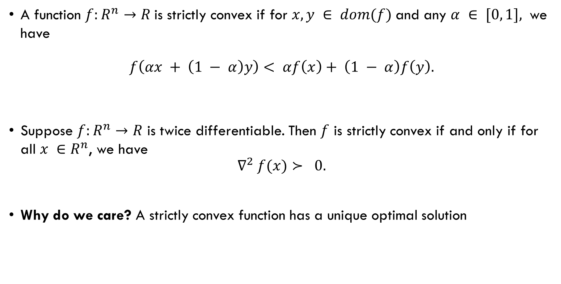
Nicer Convex Functions: Strict Convexity
A function $f:R^{n}→R$is strictly convex if for $x, y ∈ dom(f)$and any $α ∈ [0, 1],$ we have
$$f\left(αx + \left(1 − α\right)y\right)< αf\left(x\right)+ \left(1 − α\right)f\left(y\right).$$
Suppose $f:R^{n}→R$ is twice differentiable. Then $f$ is strictly convex if and only if for all $x ∈R^{n}$, we have
$$∇^{2} f(x)≻ 0.$$
Why do we care? A strictly convex function has a unique optimal solution

Slide 18
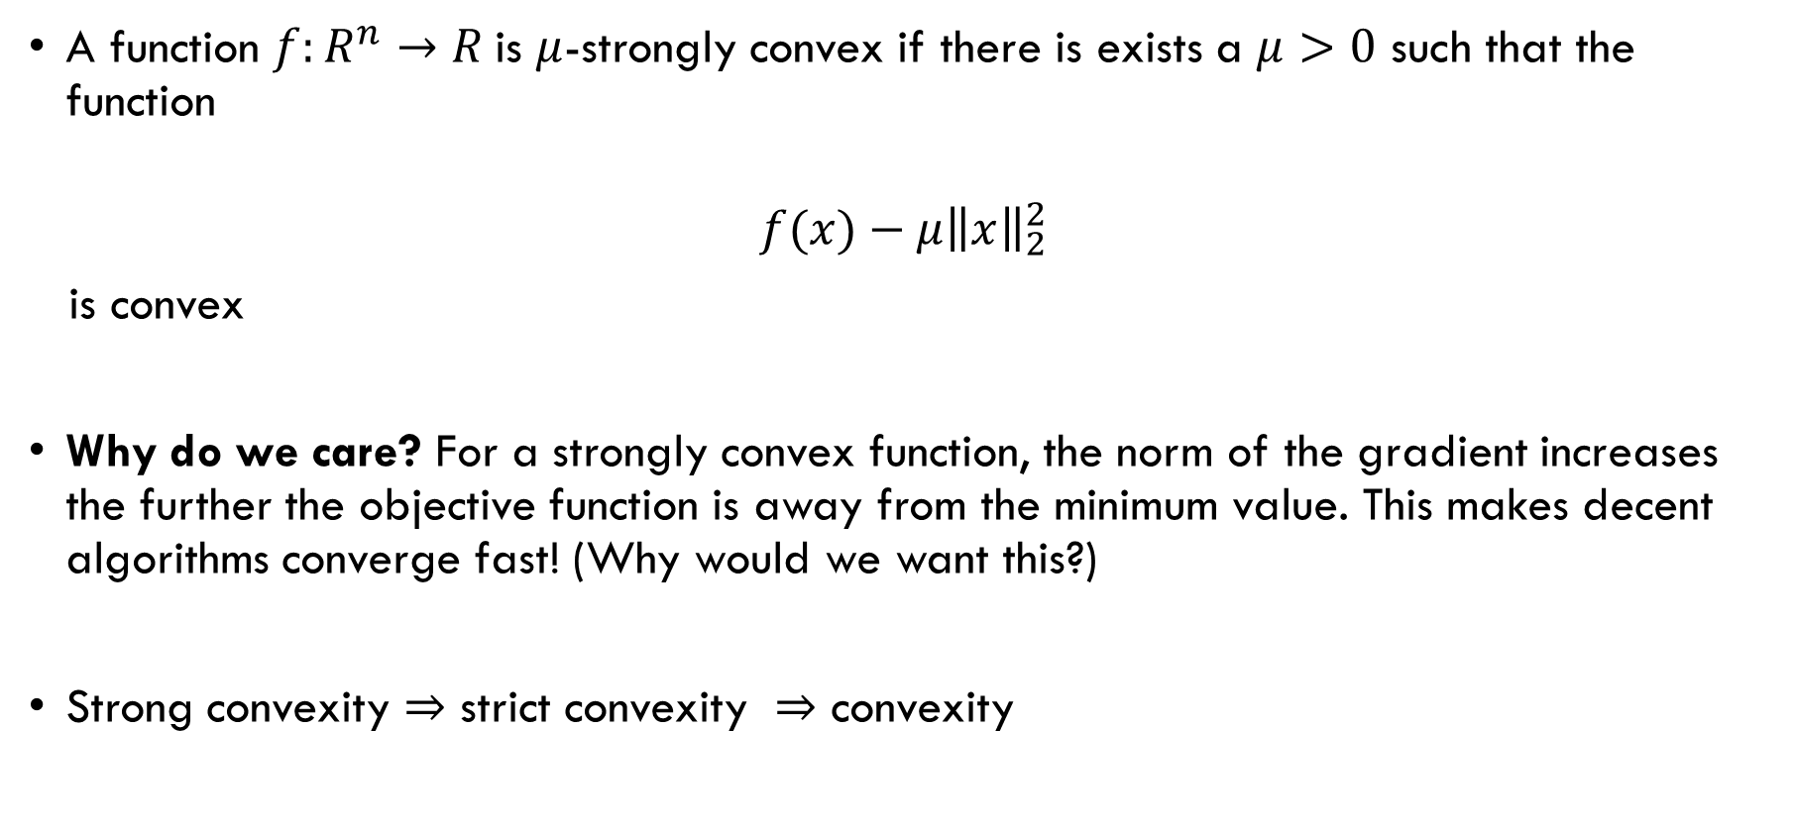
Even Nicer Convex Functions: Strong Convexity
A function $f:R^{n}→R$is $μ$-strongly convex if there is exists a $μ>0$ such that the function
$$f(x)−μ{\left\|x\right\|}_{2}^{2}$$
is convex
Why do we care? For a strongly convex function, the norm of the gradient increases the further the objective function is away from the minimum value. This makes decent algorithms converge fast! (Why would we want this?)
Strong convexity strict convexity convexity

Slide 19

Constructing a Strongly Convex Function
Suppose $f$ is a convex function that is not strongly convex
How can we modify $f$ to construct a strongly convex function?

Slide 20

Least Squares Regression
We want to build a linear regression model to predict the variable $y$
$$y=\sum_{k=1}^{K}{z_{k}}β_{k}+error$$
We need a way to determine the coefficient vector $β=(β_{1},β_{2},…,β_{K})$

Slide 21

Least Squares Regression
Suppose we have $M$ data points $(z^{m},y^{m})$, $m=1, 2, …, M$
Least squares optimization
$$\min_{β∈R^{K}}{{\sum_{m=1}^{M}{\left(y^{m}−\sum_{k=1}^{K}{β_{k}}z_{k}^{m}\right)}}^{2}}$$
Consider the column vector $y={\left(y^{1},y^{2},…,y^{M}\right)}^{T}$ and the $M×K$ matrix
$$Z=\left[\begin{matrix}z_{1}^{1} & z_{2}^{1} & … & z_{K}^{1} \\ z_{1}^{2} & z_{2}^{2} & … & z_{K}^{2} \\ ⋮ & ⋮ & ⋮ & ⋮ \\ z_{1}^{M} & z_{2}^{M} & … & z_{K}^{M}\end{matrix}\right]$$

Slide 22
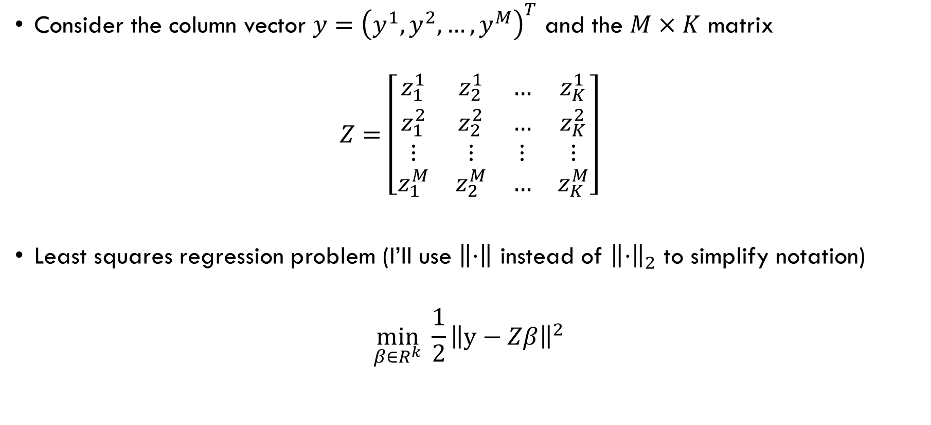
Least Squares Regression
Consider the column vector $y={\left(y^{1},y^{2},…,y^{M}\right)}^{T}$ and the $M×K$ matrix
$$Z=\left[\begin{matrix}z_{1}^{1} & z_{2}^{1} & … & z_{K}^{1} \\ z_{1}^{2} & z_{2}^{2} & … & z_{K}^{2} \\ ⋮ & ⋮ & ⋮ & ⋮ \\ z_{1}^{M} & z_{2}^{M} & … & z_{K}^{M}\end{matrix}\right]$$
Least squares regression problem (I’ll use $\left\|⋅\right\|$ instead of ${\left\|⋅\right\|}_{2}$ to simplify notation)
$$\min_{β∈R^{k}}{\frac{1}{2}{\left\|y−Zβ\right\|}^{2}}$$

Slide 23

Least Squares Regression: Convex?
Least squares regression problem
$$\min_{β∈R^{k}}{\frac{1}{2}{\left\|y−Zβ\right\|}^{2}}$$
This problem is convex. Why?
It is a quadratic form and $Z^{T}Z≽0$ (slide 13)
$$\frac{{\left\|y−Zβ\right\|}^{2}}{2}=\frac{1}{2}β^{T} Z^{T} Zβ−y^{T} Zβ +\frac{1}{2} y^{T} y$$

Slide 24

Ridge Regression
Add a 2-norm regularizer to the least squares objective with a regularization parameter $λ>0$
$$\min_{β∈R^{k}}{\frac{1}{2}{\left\|y−Zβ\right\|}^{2}}+{λ\left\|β\right\|}^{2}$$
Is this problem convex, strictly convex, or strongly convex?

Slide 25

Lasso Regression
Add a 1-norm regularizer to the least squares objective with a regularization parameter $λ>0$
$$\min_{β∈R^{k}}{\frac{1}{2}{\left\|y−Zβ\right\|}^{2}}+λ{\left\|β\right\|}_{1}$$
Is this problem convex, strictly convex, or strongly convex?

